Slide 1
Global Climate Change
Marvin Pierre

Slide 2
Overview & Objectives
Overview
The material is broken up into four major categories: evidence, causes, effects, and solutions.
Learners access the material by interaction in a virtual space, or they may also connect via desktop or mobile device.
The virtual room allows learners to physically interact with various elements of climate change at a “street level” view.
On a desktop, learners click a topic to access the module; in the virtual space, learners are transported to a room or location that replicates an exact location affected by the element being discussed.
There is a test after each module to test to gauge each learner’s grasp of the material learned. The test takes several forms: multiple choice (on desktop), performing certain activities that solve specific causes of global warming
Successfully completing the learning provides learners with awards ranging from “Responsible Global Citizen” certificate, virtual tokens that act as credit for travel to other countries, keys that open doors in other learning modules.
Objectives
Define Global Climate Change
Identify the factors that have influenced global climate change
Identify the evidence for global climate change.
Note the existing activities that curtail global climate change
Create their own methods for reducing climate change

Slide 3
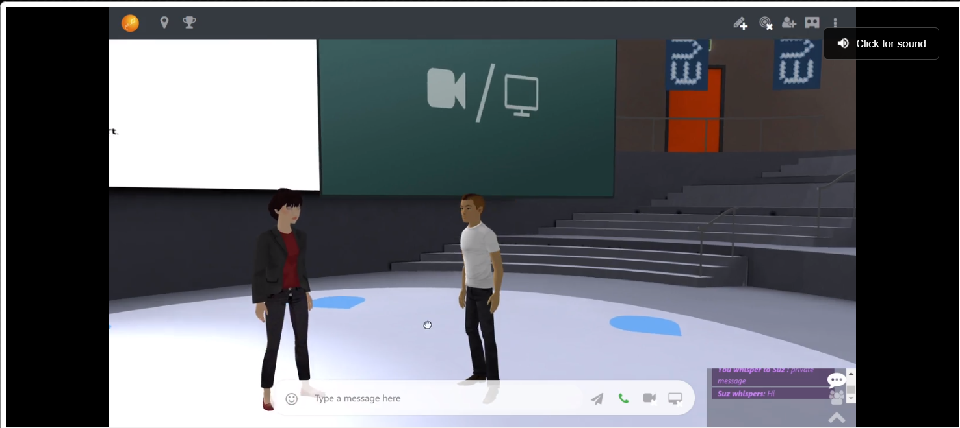
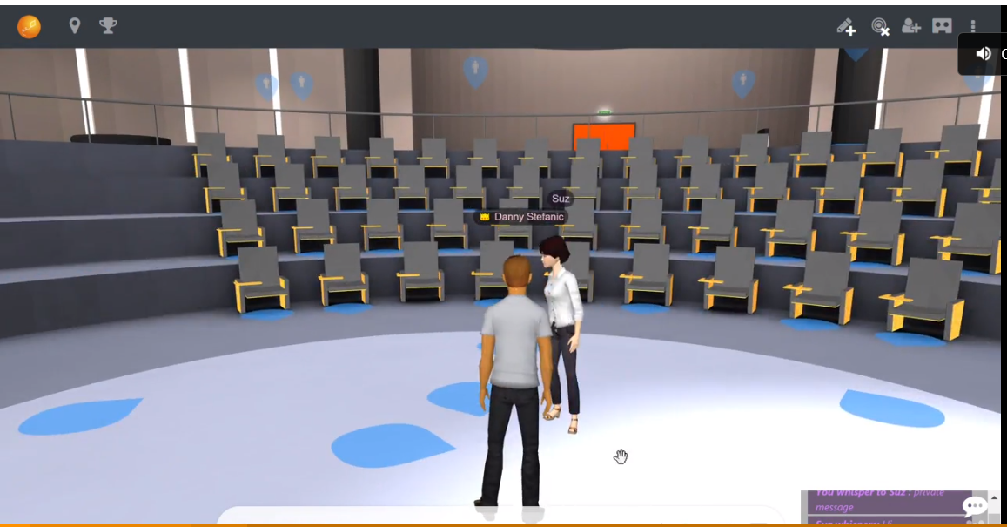
Perception and attention
Learning begins with attention to and perception of information in the learner’s environment (Alessi & Trollip, p. 21).
By creating personal avatars, learners immerse themselves in the virtual rooms. Interest is maintained by learning how to navigate the room.

Slide 4
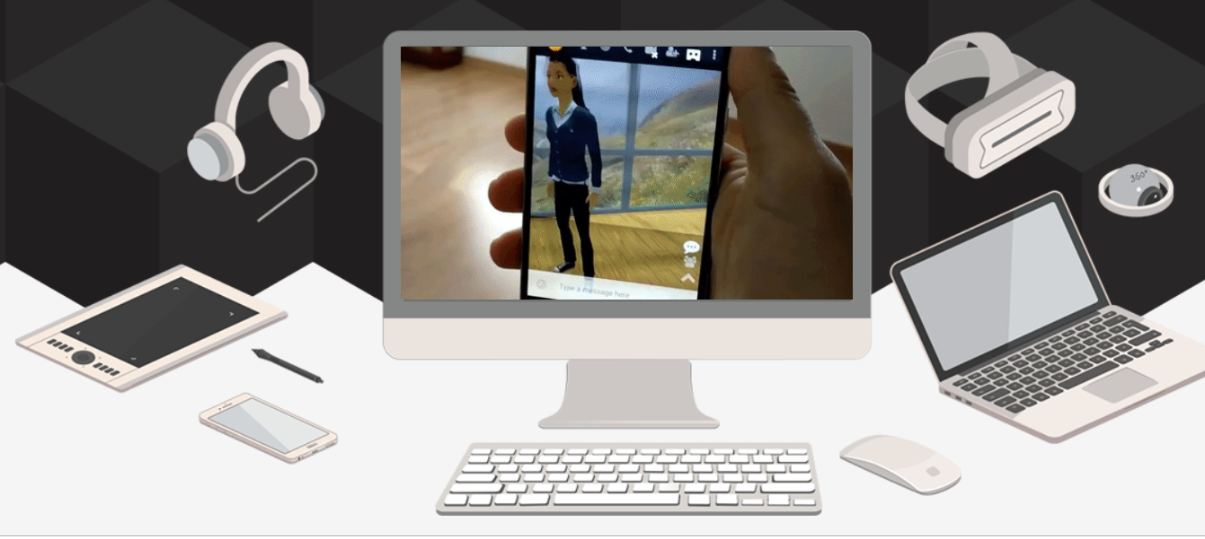
Encoding
Once the learner attends to and perceives stimuli, it must be encoded; it must be transformed into a storable format in the brain (A&T, p. 21).
Learners are fed information via desktop, audio, virtual reality headsets, or reading a script of the lesson on the computer. These methods allow learners to retain and retrieve the information in a manner that best suits them.

Slide 5
Memory
Perceived and encoded information must be retrievable for use at a later date. In order to enhance recall, information should be governed by organization and repetition.
There is a depth of information beneath all four of these categories. However, They are organized so as to alert learners of the elements (categories) that make upthe topic of climate change. One can easily recall these categories.

Slide 6
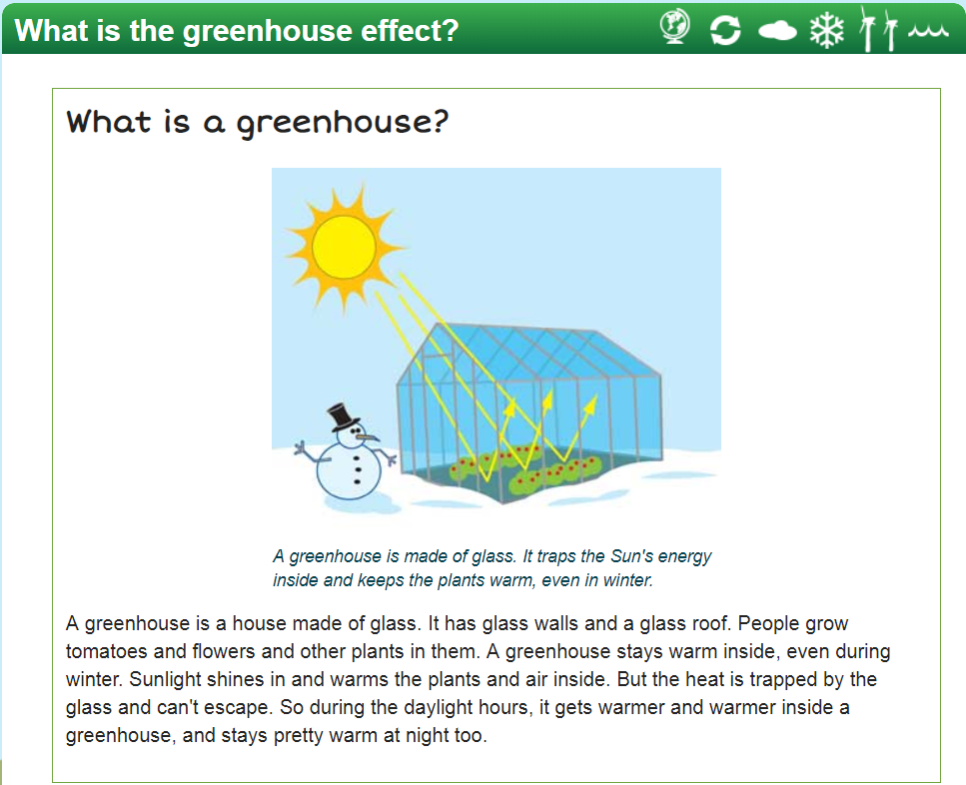
Comprehension
Information must be interpreted and integrated into our current knowledge base, i.e. we must be able to classify it, apply it, evaluate it, manipulate it, discuss it, and teach it to others.
The highly technical topic of the greenhouse effect and global warming is described using something that is easily relatable: an actual greenhouse and a snowman.

Slide 7
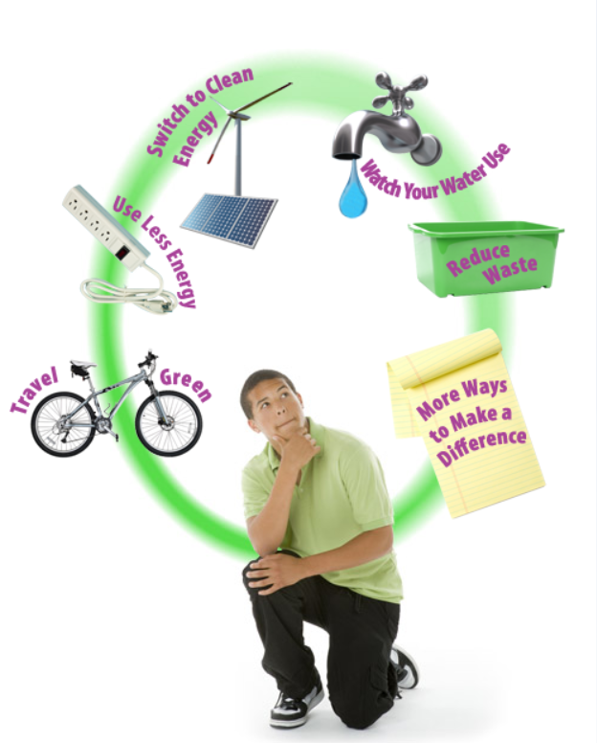
Active Learning
Learning by doing.
In the virtual space, learners can walk through the city or a room in a house actively doing the things that alleviate climate change. They are given a score at the beginning of the exercise, and the goal is to lower that score by lowering the effects of climate change.
Based on this exercises, they can create their own personal solutions for climate change.

Slide 8
Locus of control
Are instructional factors determined by the learner, the lesson program(er), or some combination of the two.
Learners have multiple ways of accessing the material in this tutorial, but overall, it is still computer-based. This tutorial is based on Guy & Lowness-Jackson (2013) findings from the Literature Review that “web-based tutorials enhance learning through the integration of the interactivity via hyperlinks, allowing learners’ control.”

Slide 9
References & Image Sources
Alessi, S. & Trollip, S. (2001). Multimedia for Learning: Methods and Development. Needham Heights, MA: Allyn & Bacon.
Images
https://www3.epa.gov/climatechange//kids/solutions/actions/index.html
https://learnbrite.com/
https://climate.nasa.gov/

